Slide 1
Application Development lab Project
Digi-News with Simplified Dictionary
BY:-
Vedanth sahu(20N31A05N7)
Priyatham(20N31A05K9)

Slide 2

Introduction
E-Newspapers are newspapers which are published electronically.
Read news Anywhere.
Read news Anytime.

Slide 3

Existing system:
*
An online newspaper (or electronic news or electronic news publication) is the online version of a newspaper, either as a stand-alone publication or as the online version of a printed periodical.
*
Going online created more opportunities for newspapers, such as competing with broadcast journalism in presenting breaking news in a more timely manner.
*
The E- Newspapers are same as the manual Newspaper but in Digital format.

Slide 4
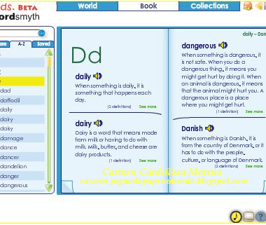

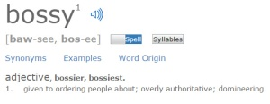
Proposed system:
Know what’s going around.
Search word meanings.
Like
Improve Learning.
See examples.

Slide 5



Modules :
Contact Us
Home
It’s the web page where the details to contact the developing team will be provided
It’s a static web page
where a person will get the news according to their interest.
About Us
It’s the Descriptive page about the Developers.

Slide 6



Technologies Used:
SKELETON:
STYLING:
APPLICATION:

Slide 7
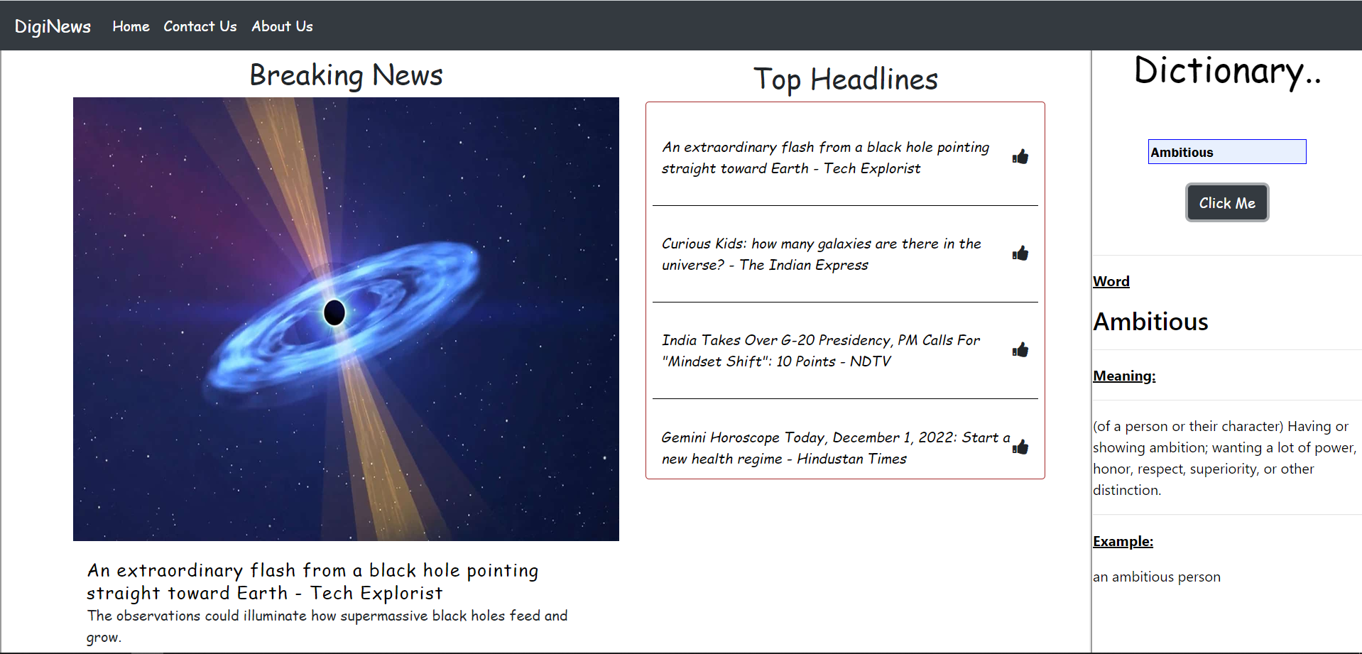
OUTPUT SCREENS

Slide 8


Slide 9
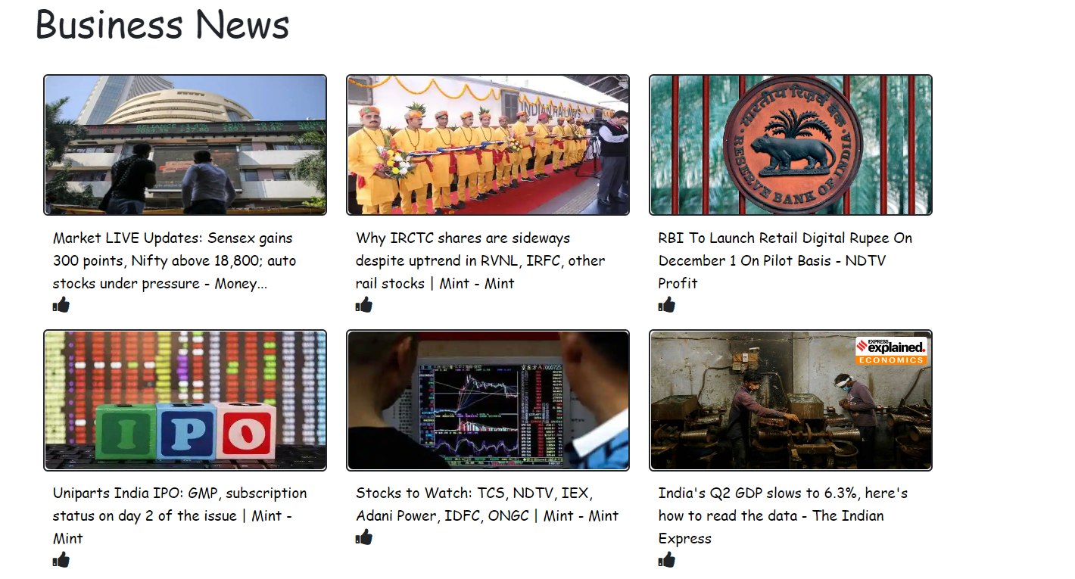

Slide 10
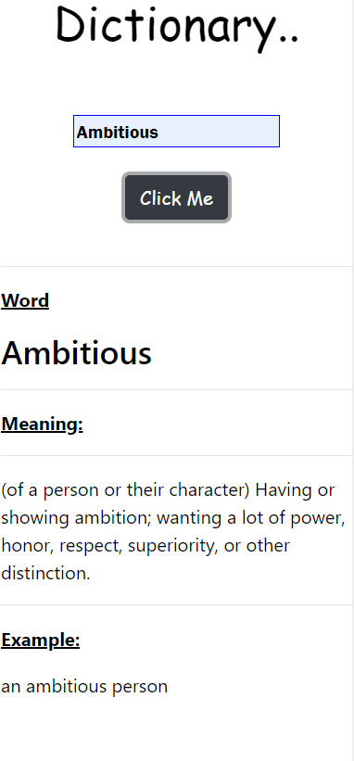

Slide 11
Thank You

